Slide 1

Client-Side Programming
Day 12

Slide 2
Working with fonts
Font Family
The font family of a text is set with the font-family property.
The font-family property should hold several font names as a "fallback" system. If the browser does not support the first font, it tries the next font.
Start with the font you want, and end with a generic family, to let the browser pick a similar font in the generic family, if no other fonts are available.
Note: If the name of a font family is more than one word, it must be in quotation marks, like font-family: "Times New Roman".
More than one font family is specified in a comma-separated list: p{font-family:Verdana, Geneva, Arial, sans-serif;}

Slide 3
Working with fonts
Font Style
The font-style property is mostly used to specify italic text.
This property has three values:
normal - The text is shown normally
italic - The text is shown in italics
oblique - The text is "leaning" (oblique is very similar to italic, but less supported)
p.italic{font-style:italic;}

Slide 4
Working with fonts
Font Size
The font-size property sets the size of the text.
Being able to manage the text size is important in web design. However, you should not use font size adjustments to make paragraphs look like headings, or headings look like paragraphs.
Always use the proper HTML tags, like <h1> - <h6> for headings and <p> for paragraphs.
font-size:16px /*This is the default font size if one is not specified.*/

Slide 5
Working with fonts
Font Color
This is actually controlled by the “color:#000000;” attribute, do not confuse background-color with color!
There is no “font-color” attribute, only “color”;

Slide 6
Applying many fonts and themes
You can apply different fonts and themes using programming languages.
This works by selecting different style sheets depending on what type of theme is selected.
You can give a user a specific set of choices and then apply a theme when the page is rendered to change the look and feel.

Slide 7
Applying many fonts and themes
You may also want to supply a mobile site that has a completely differently layout.
To do this you will generally direct users to a different location to view completely separate mobile content.

Slide 8
Understanding Web Colors
Web colors are defined by name, hex code or rgb (red green blue) value.
Typically you can select common color names such as red, blue, black, white, green, yellow etc.
You can get more specific colors by using Hex Codes.

Slide 9
Using Hex Codes
Hex Codes are specified in 3 digit or 6 digit format, preceded by a number sign (#).
Background-color:#000000 is black
Background-color:#FFFFFF is white
Background-color:#FF0000 is red
Background-color:#00FF00 is green
Background-color:#0000FF is blue.

Slide 10
Using Hex Codes
You can select Hex codes from most popular photo editing programs. Or you can use online tools to do the job as well.

Slide 11
Using Padding, Borders and Margins
Padding is the area inside an element, it can give text some breathing room before the border.
Borders are right on the edge of the element.
Margins specify spacing around the elements, to give them breathing room from other elements.
This is known as the CSS Box Model.

Slide 12
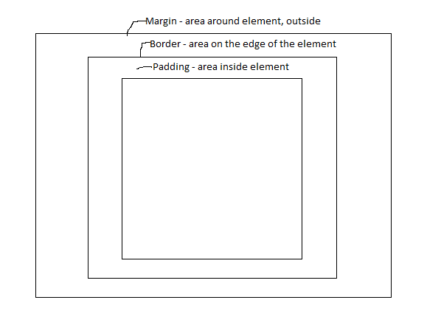
Using Padding, Borders and Margins

Slide 13
Using Padding, Borders and Margins
We can add dimensions to the top, bottom, left or right, of padding borders or margins, or add to all sides using one style attribute.
padding-top:10px; /*gives element top 10pixels of padding */
margin-bottom:10px; /*gives element bottom 10 pixels of margin*/
padding:10px /*gives all sides 10px of padding*/

Slide 14
Using Padding, Borders and Margins
Keep in mind that adding any dimensions to the box model will add to total overall pixels for the element.
For example:
width:100px; padding:20px; margin:20px;
border: solid 1px black;
Adding together the dimensions we have
100 + (20 x 2) + (20 x 2) + (1 x 2)
(width plus padding on both sides, margin on both sides and border on both sides)
the total width is 182 pixels.

Slide 15
Using Padding, Borders and Margins
Most browsers will now support “box-sizing” as we have seen before, which will allows us to include the box model dimensions along with our width and height and not add any extra pixels.
Always test on the widest range of browsers possible, or ones specifically targeted for a particular business.
For example, a lot of businesses use Internet Explorer exclusively, and older versions will not support box-sizing.
In these cases calculating the box model size is important and necessary to have proper related objects.

Slide 16
Using Ids and Classes
Id selectors are marked with a number (#) sign
#id{
/*attributes go here*/
}
Class selectors are marked with the dot (.)
.class{
/*attributes go here*/
}

Slide 17
Using Ids and Classes
Any HTML element we have can be used as a selector in CSS as well.
Uses no special character just the tag name.
IE – <p></p> tag is p{ /*attributes go here*/ } <img /> is img{ /*attributes go here*/ }

Slide 18
Using Ids and Classes
Rules for using Ids VS Classes:
Use Ids for specific circumstances
When a single element needs styling, use Id
Use classes for general circumstances
When many similar elements (such as buttons, or paragraphs) need styling, use a class.
A class can be applied to multiple elements, an Id can be applied to only one (since you should not have any elements with the same id on in a proper HTML document).

Slide 19
HTML5 New Features and Capabilities
• Advanced Site Construction
• Applying <span> and <div> elements
• Creating structure pages
• Dividing pages up into logical sections
• Precision with line height
• Styling <span> tags
• A closer look at <a> tags
• Float elements
• Absolute and Relative Positioning
• Constructing tables
• Working with table cells and rows
• Creating Web Forms

Slide 20
Advanced Site Construction
Advanced site construction is composed of many smaller, pieces to make a whole.
All aspects we have looked at so far will come into play.

Slide 21
Applying <span> and <div> elements
Our div elements allow us to set up the page in logical containers, or divisions.
Div elements are, by default, block elements
Span elements allow us to select a specific body of text and apply style to it.
Span elements are, by default, inline elements.

Slide 22
Creating structure pages
We need structure pages to use as containers for our content.
Last week’s layout exercises prepared us for understanding this material.

Slide 23
Dividing pages up into logical sections
A typical layout format is based on the main content area taking up two thirds of the page, while the remaining third is extra content.
This extra content may be a menu, links to other related articles, or ads.
The website banner is typically at the top of the page, and the footer at the bottom.

Slide 24
Dividing pages up into logical sections
Review Typical Layouts
mobilelayout.html
relativelayout.html
divpractice.html

Slide 25
Precision with line height
We can measure line height to give text more or less space.
This can add the effect of adding breathing room or fitting text into more compact areas.
Line-height:18px;
Font-size:20px; -- this will cause overlap

Slide 26
Styling <span> tags
Use span tags to highlight specific text or give a specific piece of text a different style.
You may want an italicized part or a part that is bigger, has a different color, or many other applications.
<p>Hello <span style=“color:blue;font-weight:bold;”>Joe</span>. How are you today?</p>

Slide 27
A closer look at <a> tags
Remember your anchor tags can link you to other pages as well as “anchors” that are marked by the id of the element you are pointing to.
We can stylize anchor tags like buttons and provide hover styles for an animated button look, as we did for our CSS menu.

Slide 28
Float elements
Floating elements will put them all the way left or right of a parent container element.
Once you are finished with a float element you should put another element (usually a div) after it and use the style attribute “clear:both” to clear the float.
The reason for this is that floated elements are taken out of the document flow and need to be managed.
We have seen float elements using pictures, and layouts and it is a useful application.

Slide 29
Absolute and Relative Positioning
Relative positioning takes into consideration the other elements on the page.
It will therefore move other objects out of the way, depending on its dimensions.
Absolute positioning gives us freedom to place an object where ever we want on the page.
The default positioning on elements is Static.
There is also fixed positioning. Fixed positioning works like absolute positioning, but there is a key difference.
Fixed positioning will allow an object to stay in a specific spot on the screen, in relation to the browser WINDOW and not the document within.

Slide 30
Absolute and Relative Positioning
Absolute and Relative Positioning Demos
absoluteposition.html
relativelayout.html

Slide 31

Hazard Recognition Course​
Week 1- Summary​
Hazard Recognition Course​
Week 1- Summary​

